Slide 1

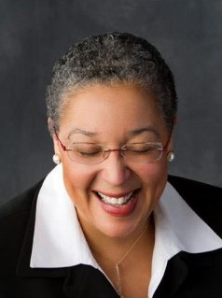
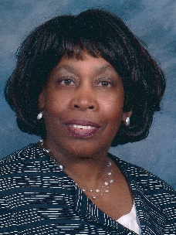
Intercultural Ministries invites you to
2018 Intercultural
Ethnic Women Conference
July 18-21, 2018 | Judson University
1151 N. State Street, Elgin, IL
Guest Leader
Rev. Dr. Zina Jacque, Pastor,
Community Church of Barrington, IL
Music Coordinator
Hornrette Washington
Contact: Florence.Li@abhms.org or 610-768-2468
In collaboration with American Baptist Women’s Ministries and Women-in-Ministry

